Slide 1
Overview of Computer Programming
Mahnhoon Lee
TRU

Slide 2
Content
What do computers look like?
What can we do with computers?
How to instruct computers to work?
Why do we learn programming?
What do we learn in this course?
Goal

Slide 3
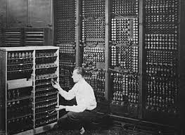
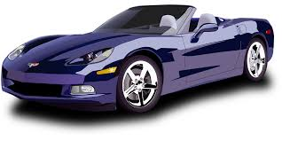
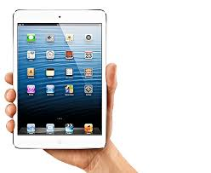
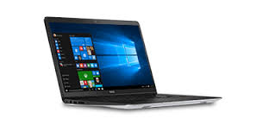
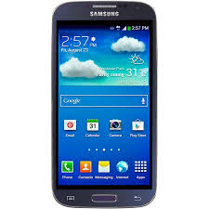
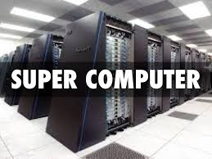
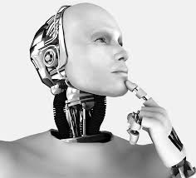
What do computers look like?

Slide 4
“If you know the enemy and know yourself, you need not fear the result of a hundred battles.”
Components?

Slide 5
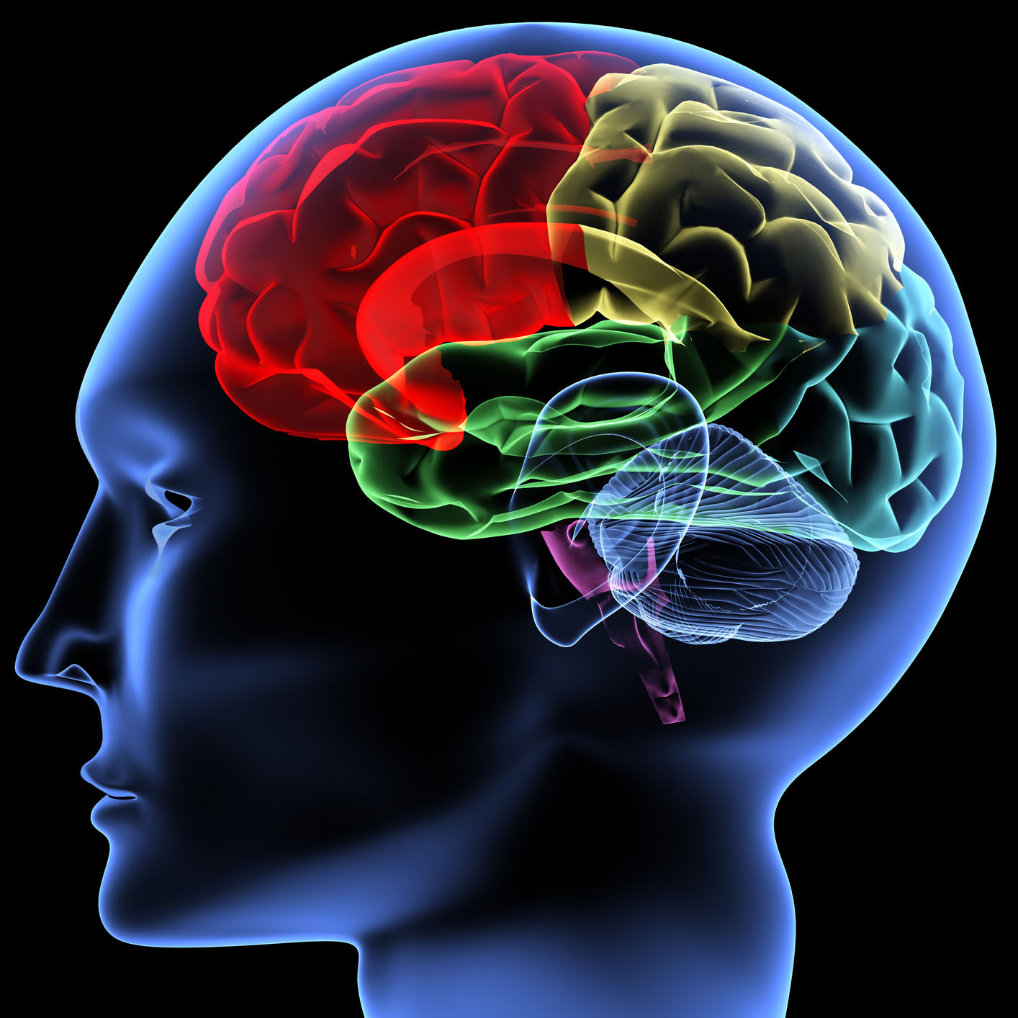
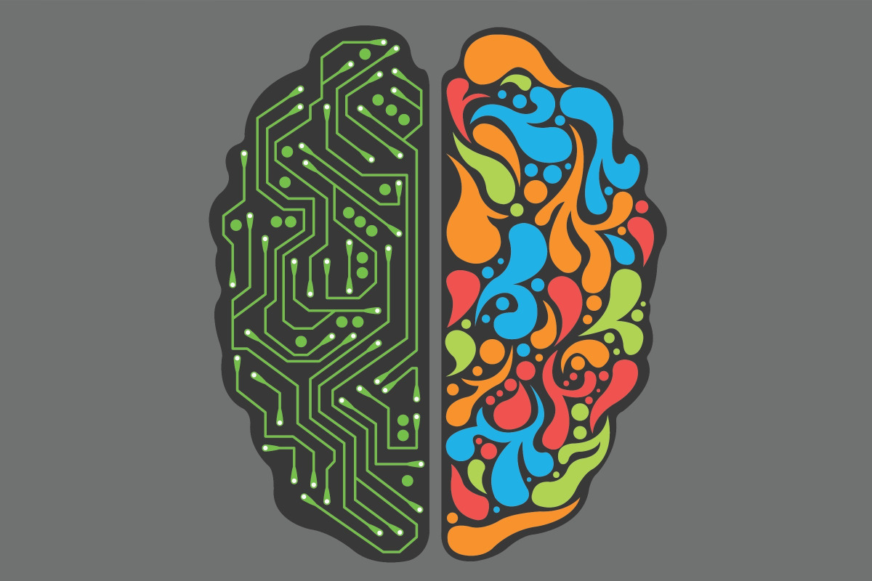
Components?
Inputs / Outputs
Processing unit
Memory

Slide 6
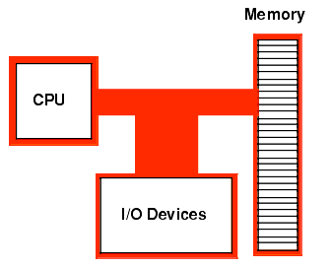
Conceptually they look like
Instructions (commands)
Data
Program
Controllers
Examples?
Program

Slide 7
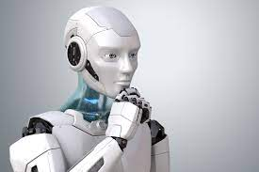
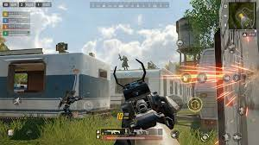
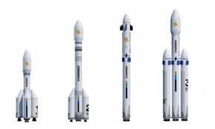
What can we do with computers?
Everything in this world?
What do you want to do with computers?
How can you make computers to do what you would like?

Slide 8
How to instruct computers to work?
Any good idea?
No AI. We need to give them very specific instructions.
How to give them instructions?
Using languages
What kind of languages can be understood by computers? English?
Machine languages that use binary numbers of 0 and 1. E.g., 10010100101111101010
Several hundred basic commands
How can we use machine languages? It is very difficult.
Then?

Slide 9
In general, people use high level programming languages that use English-like words and simple grammars
Java
C, C++, Objective C
Python
JavaScript
...
But computers cannot understand Java programming language. Then?

Slide 10
Compilation of high-level programs to machine code is required.
When you run a program, compiled code, i.e., machine code, is loaded into main memory, and executed.
Most applications that you use are compiled code. E.g.,
Web browsers such as Chrome,
MS Word, PowerPoint,
Video games
...

Slide 11
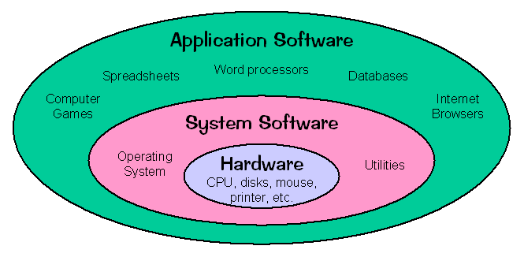
Computing platform for most applications

Slide 12
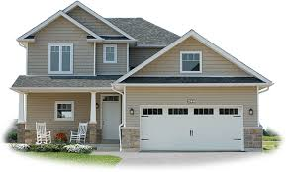
Why do we learn programming?
What is computer programming?
Do we learn computer programming or computer programming language?
How do we build a dream house?
Idea, blueprint, materials, tools such as hammer and saw – We need to know how to use tools for ...
Idea, design document, data, programming languages – We need to know how to solve … using languages.

Slide 13
What do we learn in this course?
How to use a programming language, Java, to solve problems
Simple expressions
If, i.e., selections
Repetitions
How to solve problems, i.e., how to manipulate data
How to store data into main memory
Variables
Arrays
Operations on data
Arithmetic operations – Examples?
Boolean operations – Examples?
String operations – Examples?
Built-in operations (like services)

Slide 14
How to solve problems, i.e., how to manipulate data
E.g., how to compute the average of given numbers?
E.g., how to find the largest among given numbers?

Slide 15
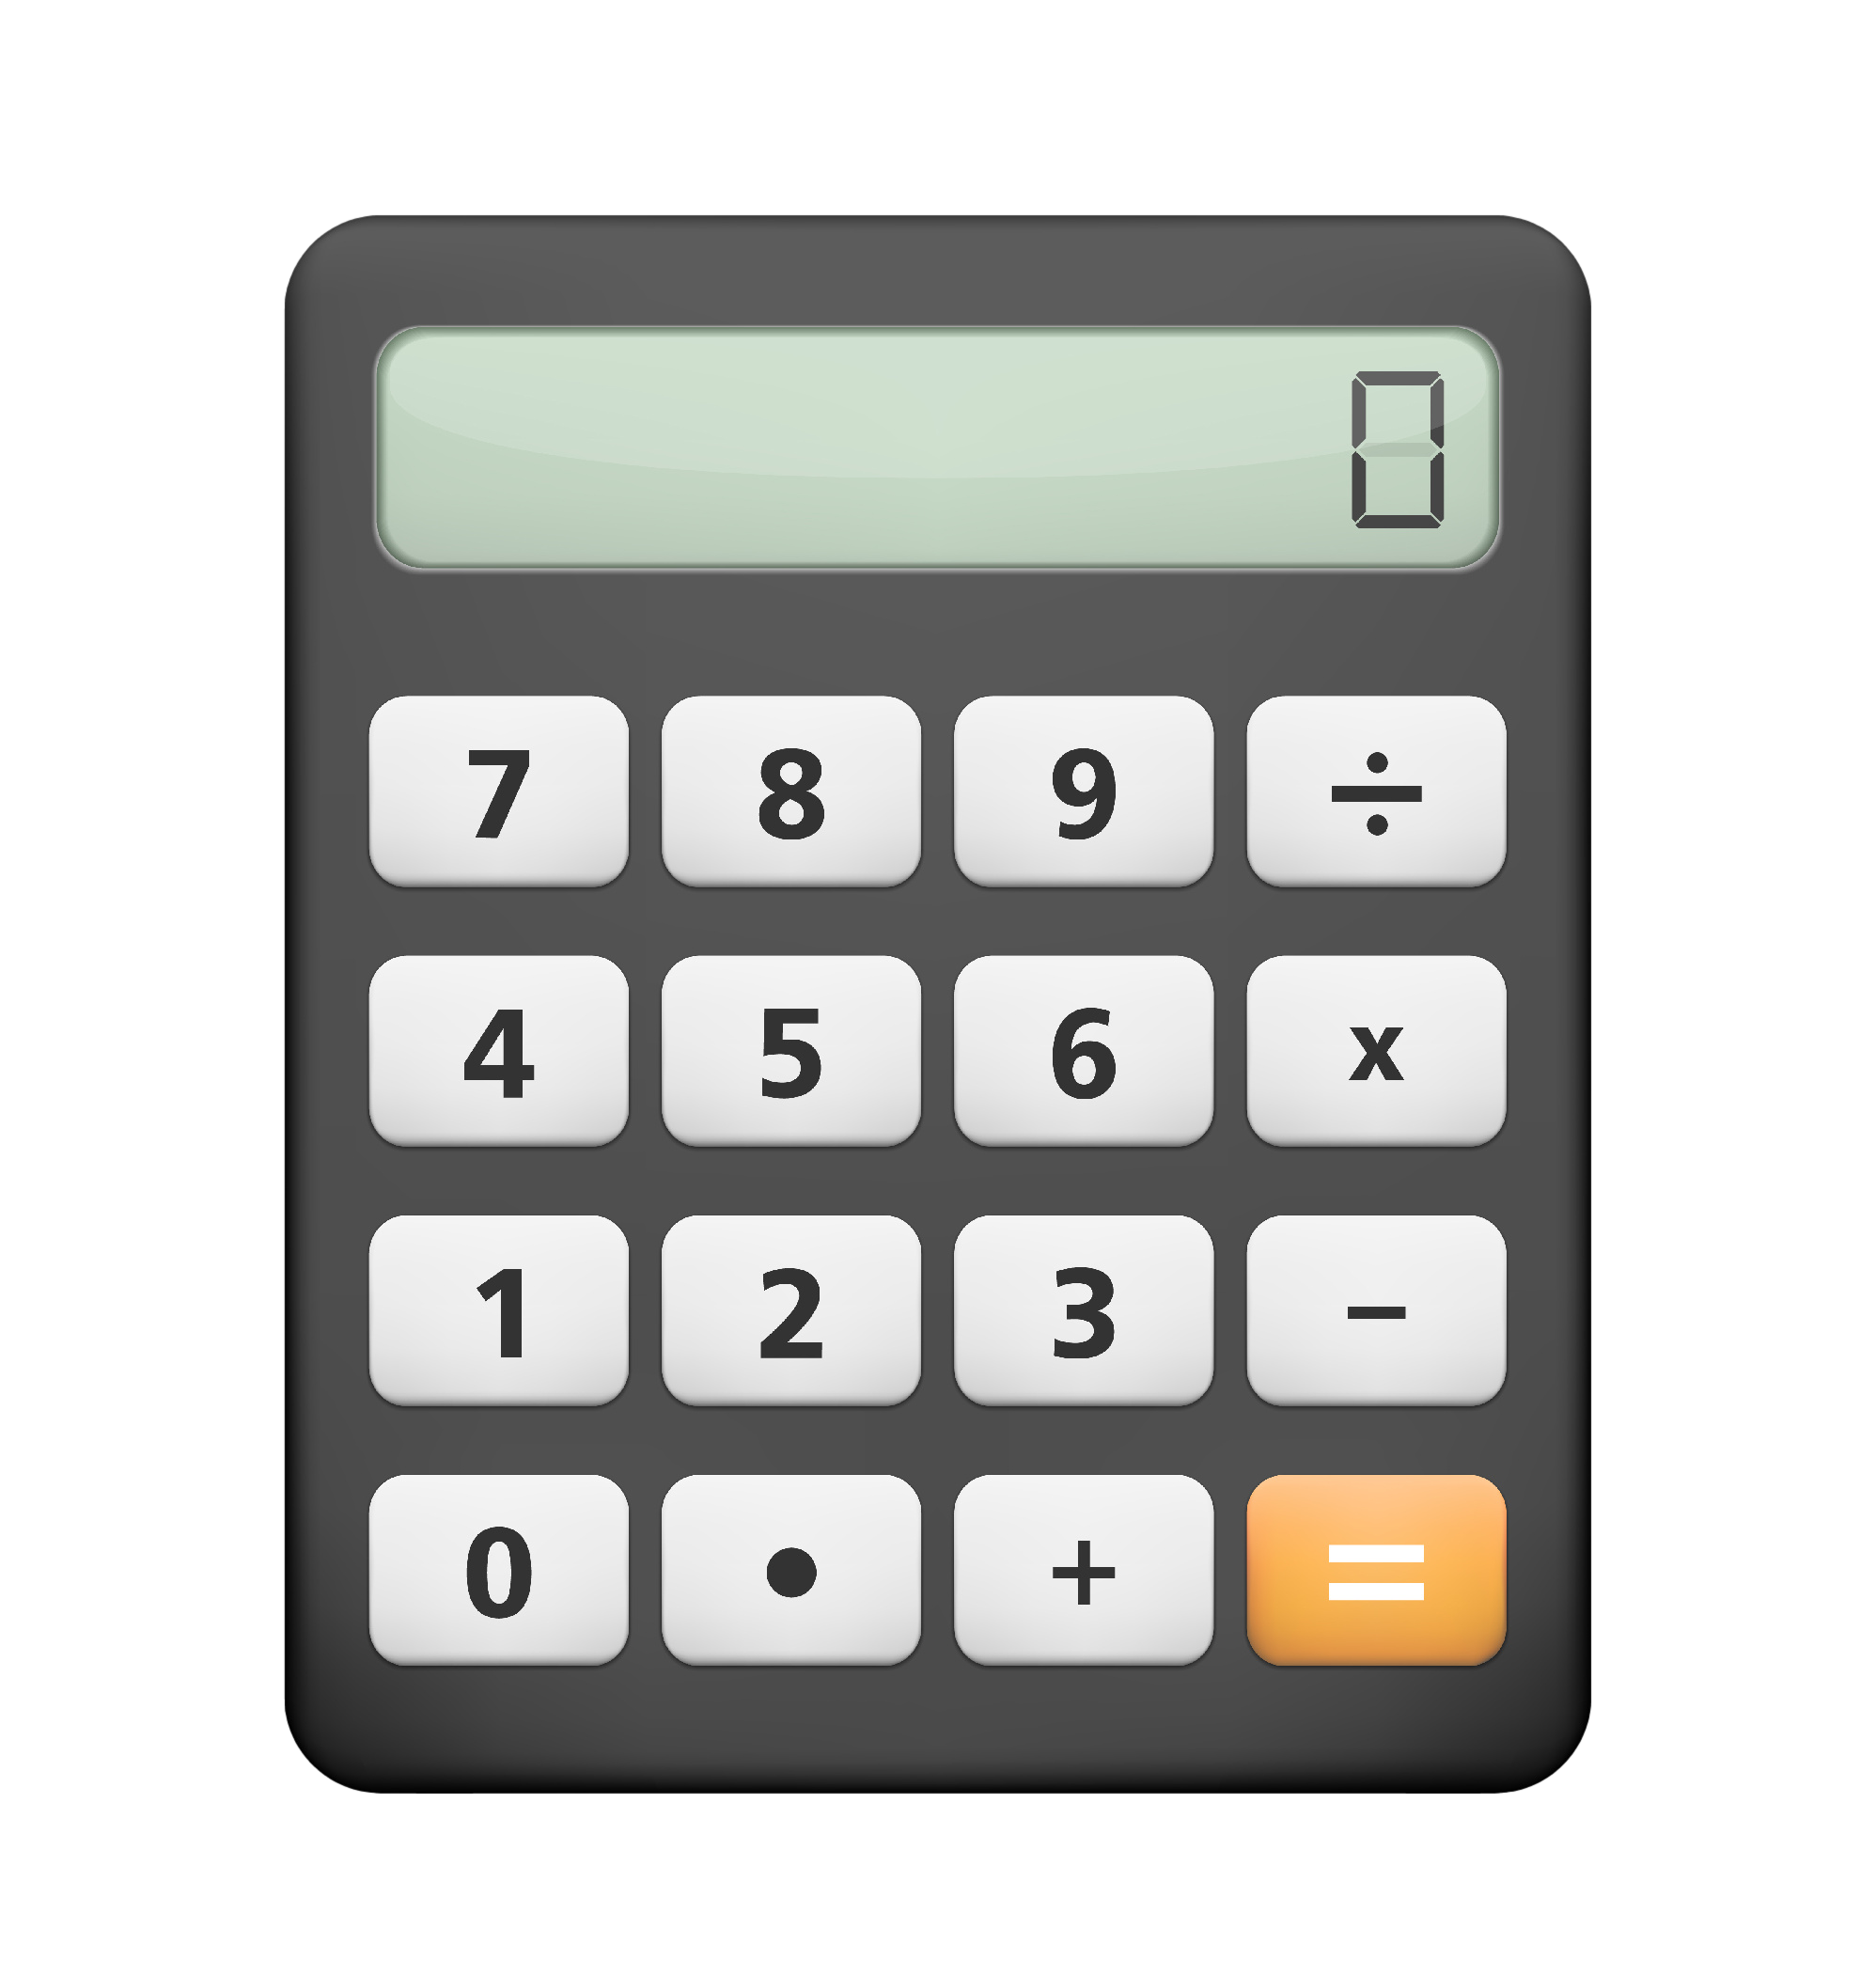
Goal
Computer programming is VERY easy.
Can you write a simple calculator application?

Slide 16
Are you ready?
How to learn GOOD programming skills and problem-solving skills?

